Slide 1
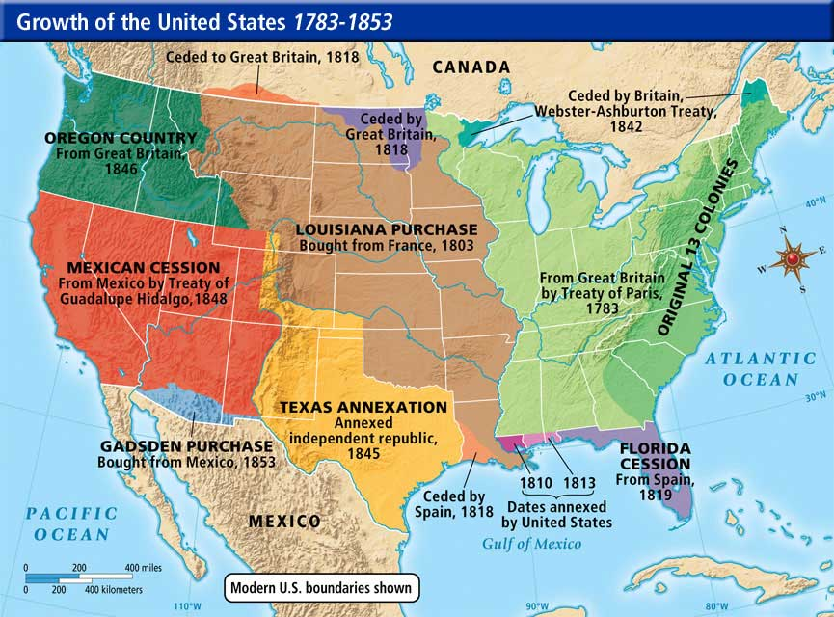
Tri-Territory Historic Site, near Farson, WY

